Slide 1
SMART IRRIGATION SYSTEM
Group F
CHEMESE DOMZANELE
MAPHALLA THATO
THOABALA SELLO
C&P Course
Notes:
Note:

Slide 2
SMART IRRIGATION SYSTEM
UNIT 1. Introduction
UNIT 2. Problem Statement
UNIT 3. Objectives
UNIT 4. System Requirements
4.1 Hardware and Software Requirement
4.2 Functional Requirements
UNIT 5. Challenges
UNIT 6. Conclusion
UNIT 7. Future Scope
Notes:
Note:

Slide 3
UNIT 1. INTRODUCTION
Agricultural plays a crucial role in sustaining the livelihoods of millions of individuals globally by providing essential resources such as food, fiber and fuel. Despite its essential value, a lot of agricultural regions have a lot of difficulties, especially when it comes to crop output due to improper irrigation techniques. Therefore, an innovative solution to these problems is offered by irrigation system which will regulate the flow of water to the crops in order to promote their growth and raise agricultural output.
Notes:
Note:
Some examples of random experiments are:
+Flipping a coin.
+Rolling dices.
You will start with these simple examples and build a basis of probability.

Slide 4
UNIT 2. PROBLEM STATEMENT
Inadequate irrigation results in pests and diseases on crops, which lowers crop yield.
Wastage of water.
Much time and human resources are required for collecting water from the rivers and irrigating crops.
Failure to provide real-time, accurate information about soil condition

Slide 5
UNIT 3. OBJECTIVES
Increase the food production by using advanced irrigation system.
Determine when and how much water is needed, avoiding overwatering and under watering of crops.
Reduce wastage of human resources and time.
Take proper action regarding the condition of the soil through the proposed system.

Slide 6
UNIT 4. SYSTEM REQUIREMENTS
4.1 Hardware and Software Requirements
Proteus Simulator
Microcontroller: Arduino, Raspberry PI, PIC 16f887
Soil Moisture sensor
Water level Sensor
Visual Studio Code
PC / Laptop
Bluetooth
Liquid Crystal Display(LCD)

Slide 7
4.2. Functional Requirements
Soil moisture sensor: Measures the moisture level in the soil and outputs the data both in digital and analog forms.
Water level sensor: Monitors the water level in a tank. It can provide either digital or analog signals indicating the water level.
Both sensors sends their data to the microcontroller.
Microcontroller: Reads output from both sensors. It also converts the analog signals to digital value that represent the soil moisture level and water level and this values are mapped into percentage for better understanding. Based on moisture level, it decides whether to activate the relay to turn the pump on if the moisture level is low or turn off if it is high.
System: Continually controls the soil moisture and water level and adjust the irrigation accordingly. This ensures that the crops receive the right amount of water.

Slide 8
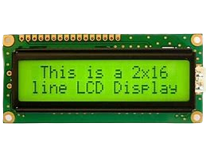
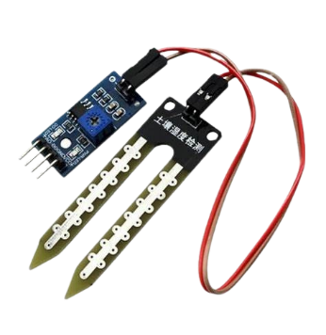
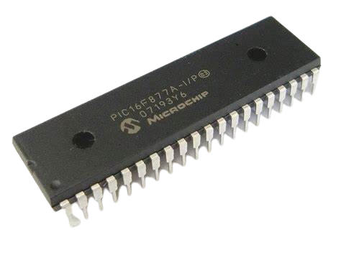
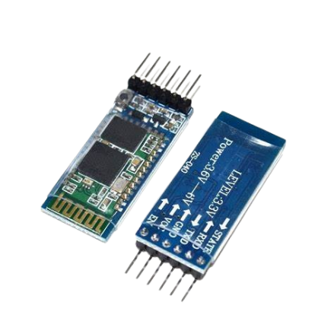

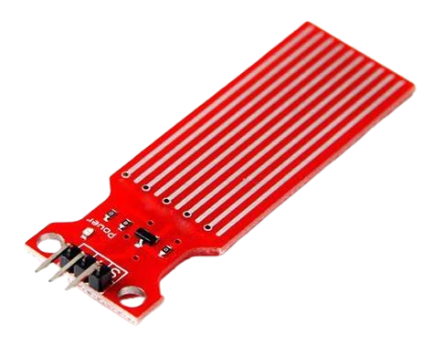
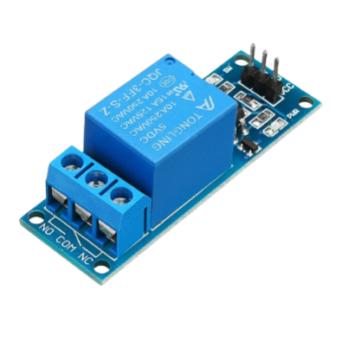
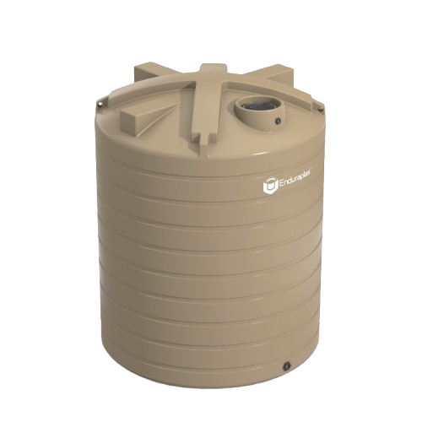
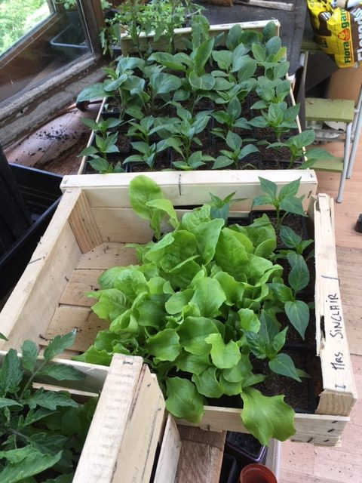
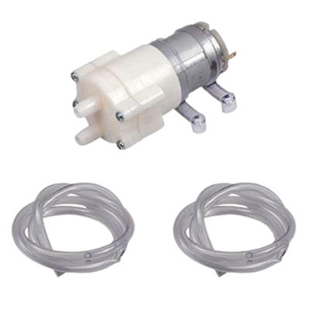
Conti…..
Soil moisture sensor
Liquid Crystal Display
Microcontroller
Laptop
HC-05/06 Bluetooth module
Water Level Sensor
Relay Module
Crops plot
Water pump
Water tank

Slide 9
UNIT 5. CHALLENGES
The smart farming based equipment require farmer to understand and learn the use of technology
The smart irrigation need availability on internet connectivity.
Fault sensor or data processing engines can cause faulty decision which may lead to over use of water and other wastages of resources.

Slide 10
UNIT 6. CONCLUSION
Smart irrigation has gained significant attention as the need to improve water use efficiency increases. Monitoring and control require sensors to collect real-time information for irrigation scheduling decisions. An irrigation control strategy has to be adopted for irrigation decisions. Closed-loop irrigation strategies with feedback from sensors are widely used for real-time irrigation decisions. Smart irrigation can save irrigation water and improve yield at the farm level, consequently leading to improved food security for the global population. In all the irrigation systems, it is possible to implement smart strategies that can help in saving irrigation water and improve yields.

Slide 11
UNIT 7. FUTURE SCOPE
Future development could concentrate more on adding more sensors to the system in order to collect more data, particularly on pest control, and incorporating a GPS module to further develop agriculture IoT technology and provide a product that is ready for precision farming.
The proposed work can be improved by expanding this system to cover huge areas of land, even though it can be implemented in real time.
Additionally, the system can be incorporated to monitor crop development and soil quality in each soil.

